Slide 1
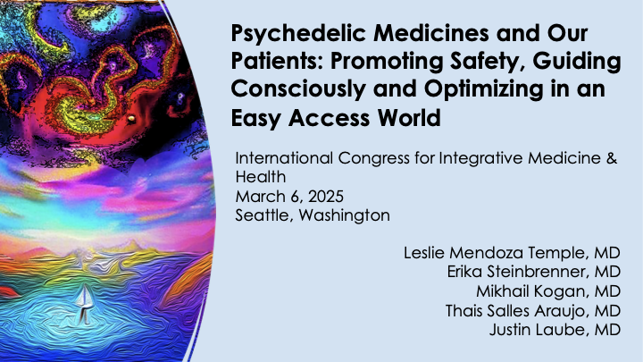

Slide 2
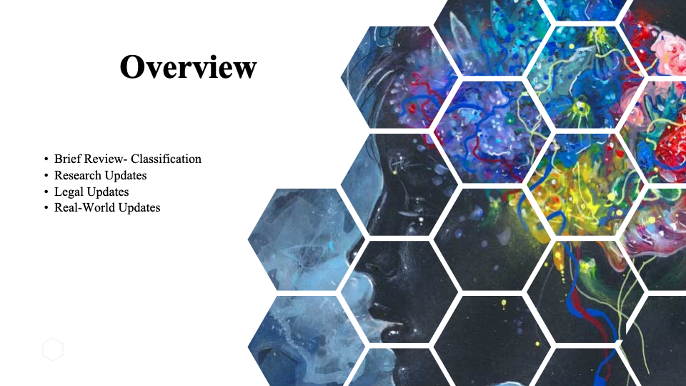





2024 Cleveland
Arriving and nesting psychedelics within integrative medicine
Historical and cultural context of psychedelic substances
Broad overview of psychedelics from conventional medicine viewpoint
Ethics, Safety

Slide 3
From last year in Cleveland, IRCIMH 2024
Mescaline from Peyote, San Pedro and Peruvian Torch cacti
DMT and Ayahuasca
5-Methoxy-DMT or “The Toad”
Ibogaine
LSD
MDMA
Kratom*
Psilocybin
Ketamine
*not a psychedelic substance

Slide 4


As your questions and comments arise, enter them in the WHOVA app.
You can upvote questions or ask your own.

Slide 5


Slide 6
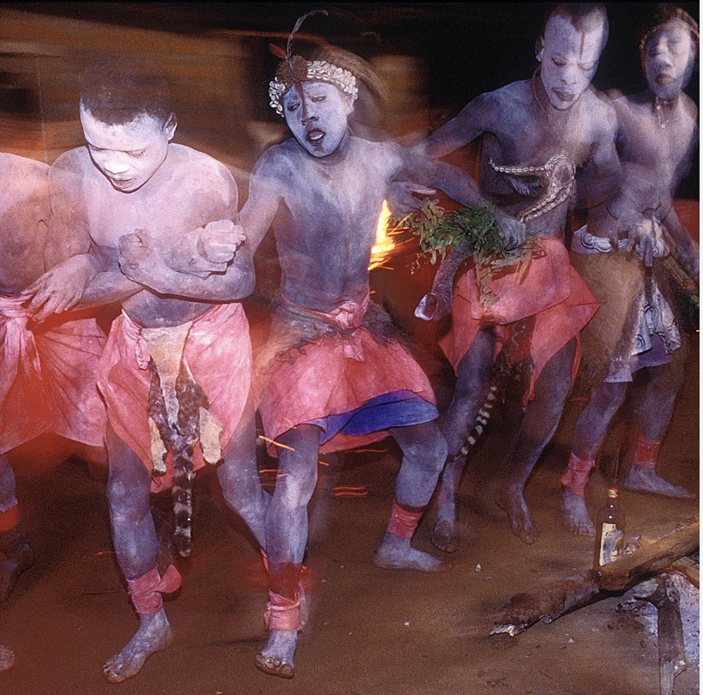
Cultural Roots & Westernization
It is our job to acknowledge and respect the wisdom of the cultures that have shared their tools of healing and medicine with the world.
“There is a lack of diversity within the field of psychedelic researchers, with Indigenous people and people of color underrepresented both as researchers, therapists, and participants in studies.”
George JR, Michaels TI, Sevelius J, Williams MT. The psychedelic renaissance and the limitations of a White-dominant medical framework: a call for indigenous and ethnic minority inclusion. J Psychedelic Stud. 2020;4:4–15.
Michaels TI, Purdon J, Collins A, Williams MT. Inclusion of people of color in psychedelic-assisted psychotherapy: a review of the literature. BMC Psychiatry. 2018;18:1–9.
Notes:
Leslie- My role will be to help set the stage, starting with a gong/bell, a fewcentering breaths and a call to prepare the mind to receive new information. I will acknowledge the peoples and cultures that originated this form of healing, and then go through the agenda. The 2 or 3 patient cases will be highlighted as food for thought throughout the presentation. I will state that we are going through the psychedelic substances which the general U.S.practitioner might be most likely asked about during patient visits or outside the clinic: namely Ketamine, psilocybin, MDMA, and Ayahuasca. I will share the link for our slides from last year for reference. I will also make a general comment about how regulation is rapidly changing regarding psilocybin, and that the state of MDMA is in flux with last year's FDA hearings, and that Ketamine is the only legal psychedelic substance in the U.S.
In the meantime, we as healthcare professionals must be ready to discuss these substances with authority and confidence, rather than playing catch up since they are already being utilized, whether legal or not (draw parallel to cannabis).

Slide 7

Agenda
I. Toxicity, hospitalizations from psychedelics
II. Ketamine & MDMA
III. Psilocybin & Ayahuasca
IV. Compare & contrast
V. The patient experience
VI. Moderated Q & A
Notes:
My role will be to help set the stage, starting with a gong/bell, a few centering breaths and a call to prepare the mind to receive new information.
I will acknowledge the peoples and cultures that originated this form of healing, and then go through the agenda.
2 or 3 patient cases will be highlighted as food for thought throughout the presentation. I will state that we are going through the psychedelic substances which the general practitioner might be most likely asked about during patient visits or outside the clinic, namely Ketamine, psilocybin, MDMA, and Ayahuasca.
I will share the link for our slides from last year for reference.
I will also make a general comment about how regulation is rapidly changing regarding psilocybin, and that the state of MDMA is in flux with last year's FDA hearings, and that Ketamine is the only legal psychedelic substance in the U.S.
In the meantime, we as healthcare professionals must be ready to discuss these substances with authority and confidence, rather than playing catch up since they are already being utilized, whether legal or not (draw parallel to cannabis).

Slide 8

Hold these patients in your mind
Peter
A 55 y veteran with severe combat - related PTSD and treatment-resistant depression.
Many medications have failed with minimal or only temporary benefit from therapy and lifestyle changes.
Kate
A 62 y with metastatic ovarian cancer struggles with accepting death and finding faith again.
She wants to try psilocybin after reading small trials showing strong benefit in palliative settings.
Brian
A 36 y with decades of depression impacting his relationship with wife and 2 children
He wants to try psilocybin after his friend had a good experience.
Henry
A 53 y going through divorce is feeling anxiety and depression.
He is curious about going away on an Ayahuasca retreat in South America and asks what you think of the idea.

Slide 9
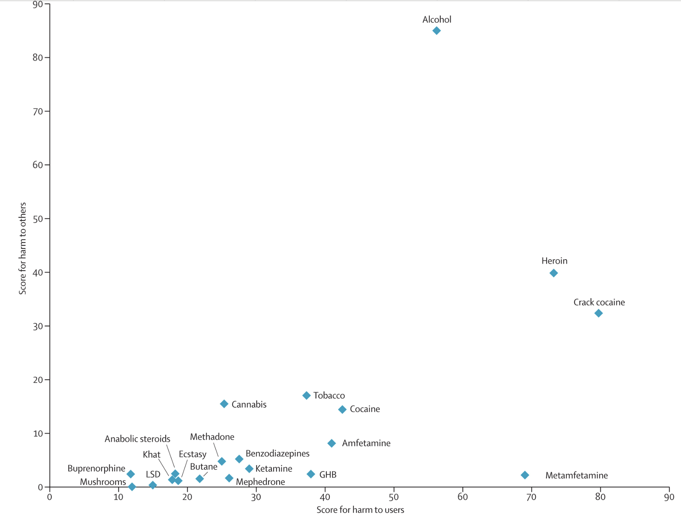
Drugs shown for their harm to self and harm to others
Nutt DJ, King LA, Phillips LD. Drug harms in the UK: a multicriteria decision analysis, The Lancet, Vol 376, Issue 9752, 2010,

Slide 10
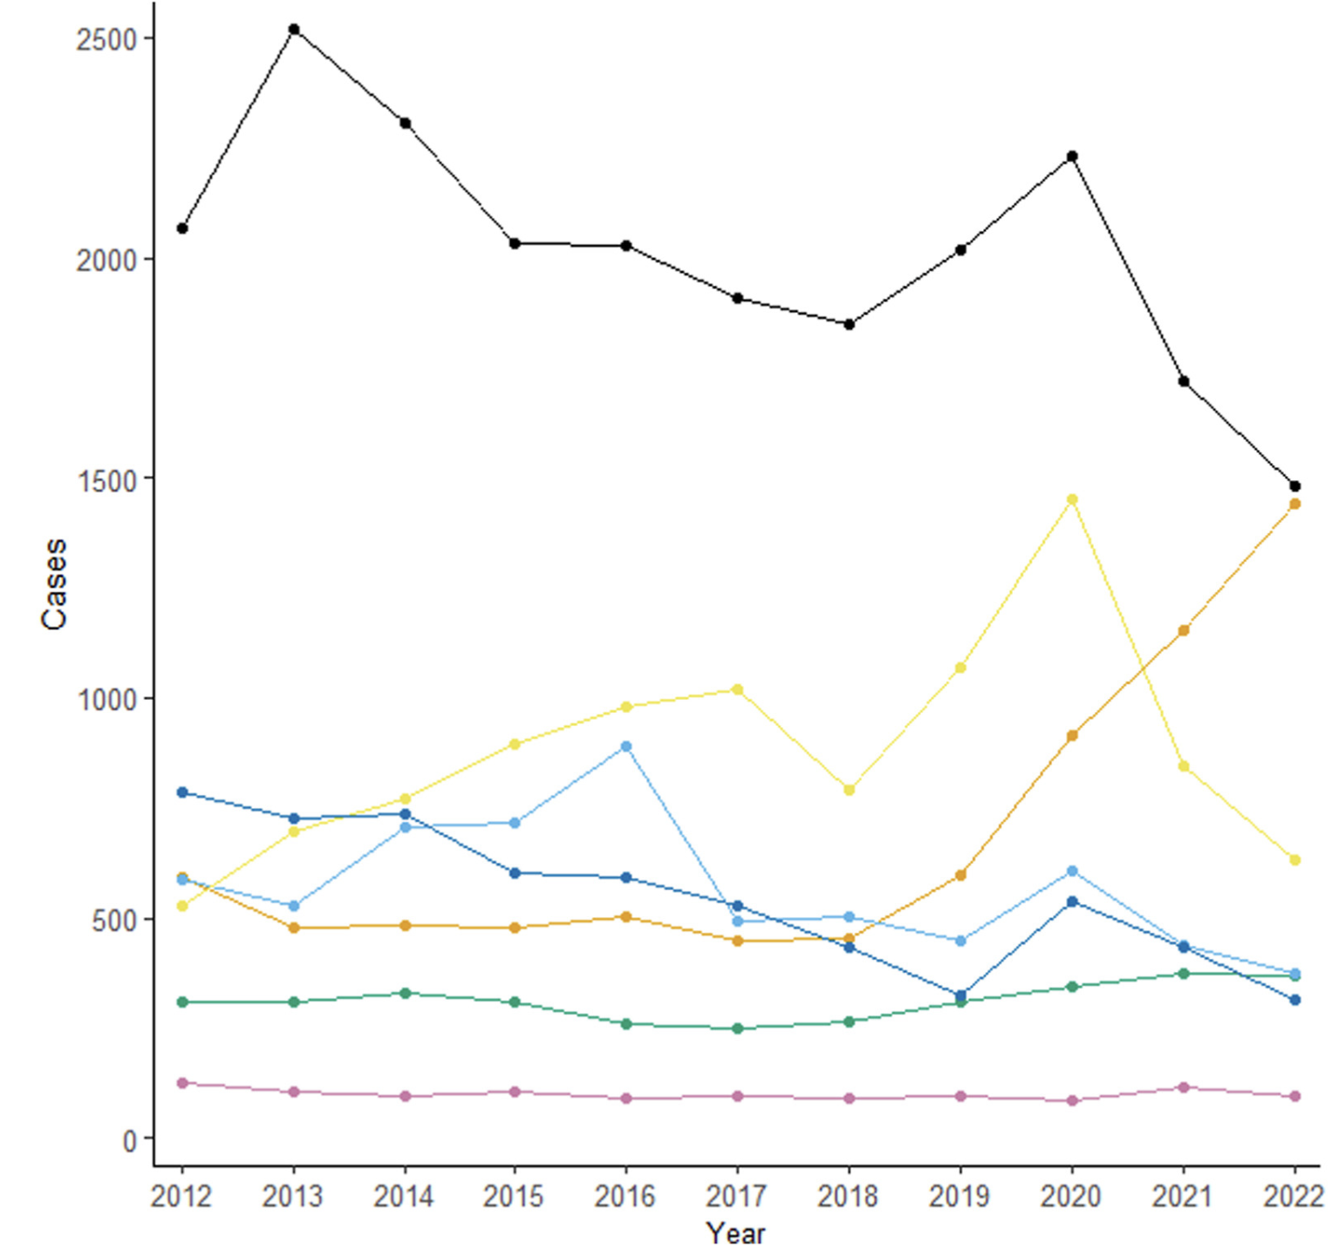
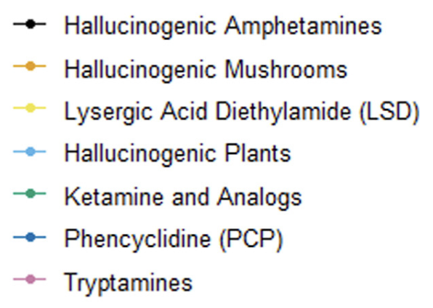
10 year National Poison Data: 54,605 psychedelic exposures.
42% required medical treatment; 0.5% died (265 patients)
Amphetamines (MDMA)
LSD
Psilocybin
Ketamine
Tryptamines (DMT)
Simon MW, Olsen HA, Hoyte CO, Black JC, Reynolds KM, Dart RC, Monte AA. Clinical Effects of Psychedelic Substances Reported to United States Poison Centers: 2012 to 2022. Ann Emerg Med. 2024 Aug
Notes:
Hallucinogenic mushroom exposures increased most over the study period
Overall, 27,444 (50.3%) psychedelic exposures had symptoms that required treatment, severe residual or prolonged symptoms, or death.
Cardiovascular effects were common, especially with MDMA (31.1%).
Patients managed in or referred to a health care facility received medical therapies in 62.4% of cases, including sedation (32.9%) and respiratory interventions (10.3%).

Slide 11
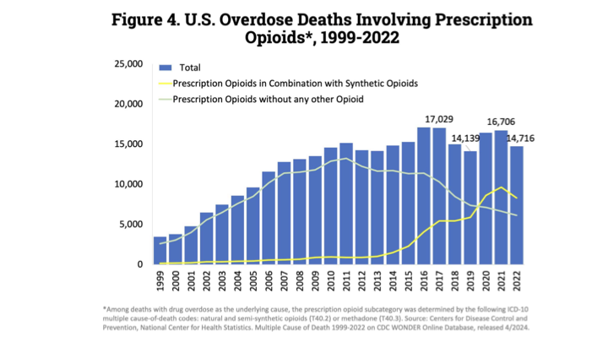

Slide 12
Regulation

Slide 13
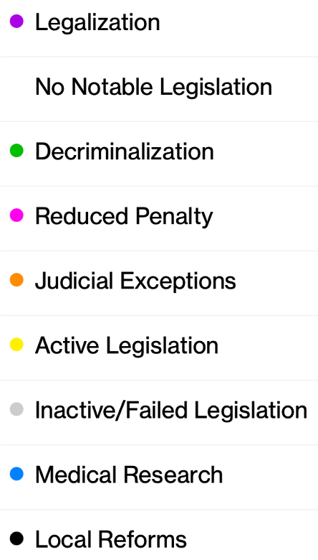
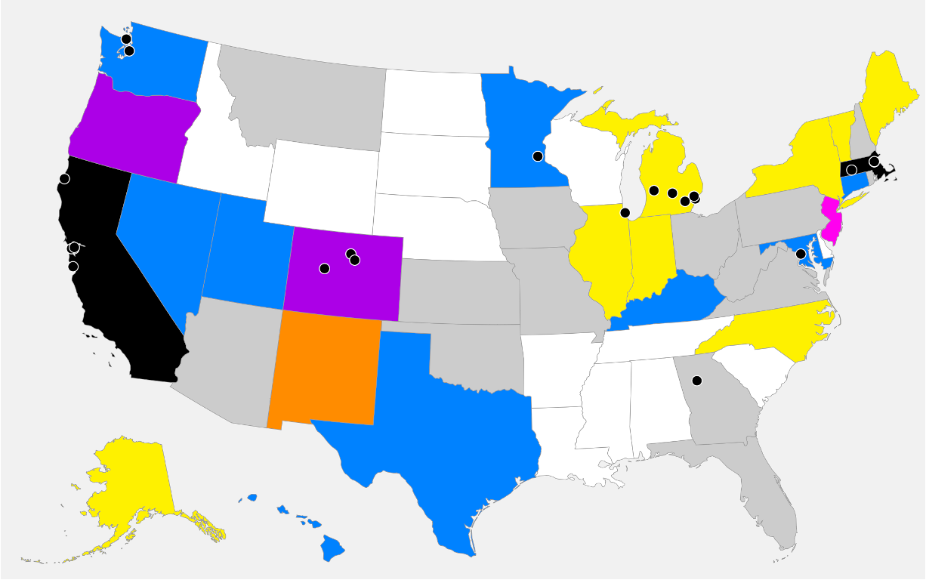
Where are psychedelics (psilocybin) legal in the U.S?
Ketamine is legal in U.S.
OR
CO
As of February 14, 2025
https://psychedelicalpha.com/data/psychedelic-laws

Slide 14
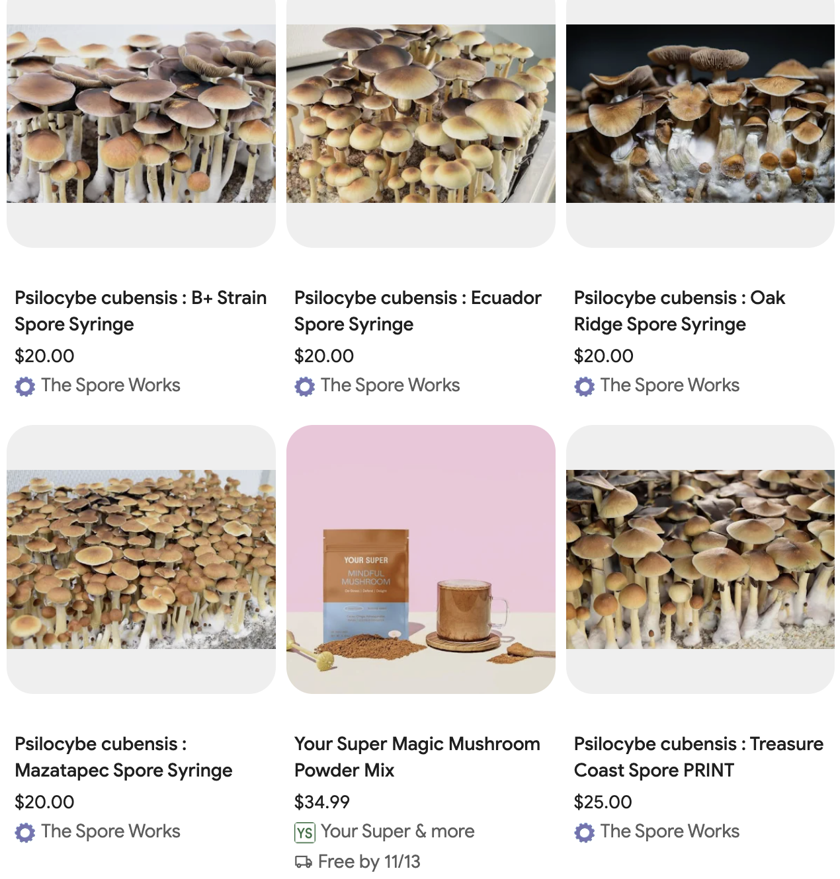
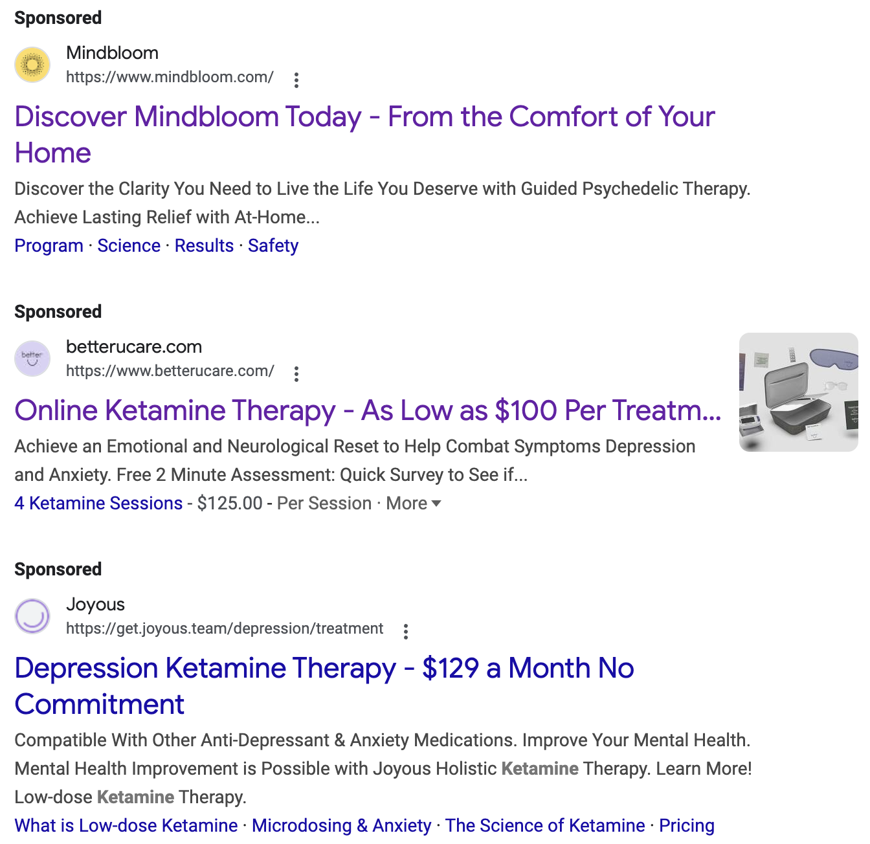
What about mail ordering psychedelic mushrooms & ketamine?
We do not endorse any company. For illustrative purposes only.

Slide 15
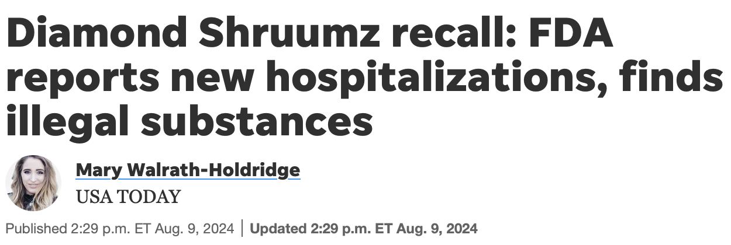
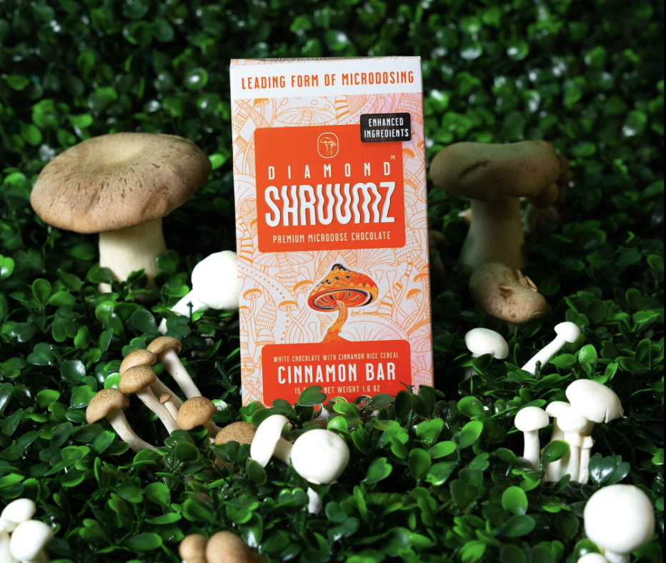
“On Thursday, the FDA released the first round of lab results from testing done on different Diamond Shruumz chocolate bars, revealing that some of the products contained prescription or controlled substances and unlisted compounds.
113 total reported illnesses
42 hospitalizations
2 potentially associated deaths across 28 states.
Psilocin found (expected for Psilocybe spp).
Muscimol found (in Amanita muscaria).
Pregabalin (Lyrica™) found in 3 of the bars.
Kavalactones also found (from kava).

Slide 16

Leslie Me
Ketamine vs. MDMA:
A Case-Based Approach
Erika Steinbrenner, MD
Imagine Healthcare, Epiphany Wellness, Symetria Recovery
Notes:
Both have distinct mechanisms and applications.

Slide 17
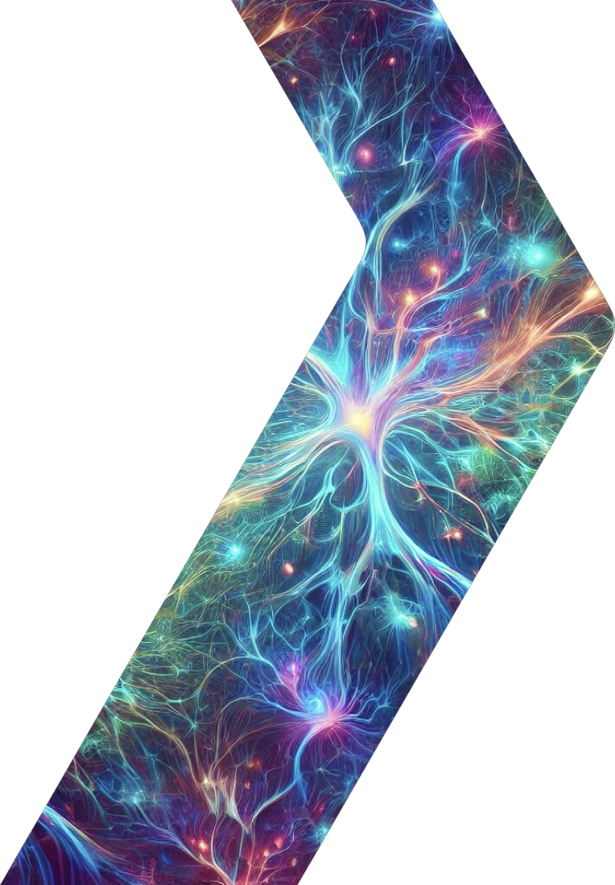
Patient Profile - Peter
55-year-old male veteran with PTSD and TRD
Psych History:
  Childhood sexual trauma, military trauma
  Multiple failed antidepressant trials
  Minimal benefit from therapies (EMDR, CBT)
  No psychosis, no substance abuse.
Current Symptoms:
  Severe PTSD (CAPS-5 Score: 50)
  Severe Depression (PHQ-9: 22)
  Passive suicidal ideation.

Slide 18
Patient Profile
Medical History
  Denies significant chronic health concerns
Current Medications
  Venlafaxine 225 mg
  Prazosin 3 mg qHS

Slide 19
Ketamine or MDMA-Assisted Therapy?
Look at the Therapies
  Mechanism of Action
  Subjective Effects
  Indications
Patient Considerations
  Contraindications
  Medication Interactions
  Accessibility

Slide 20
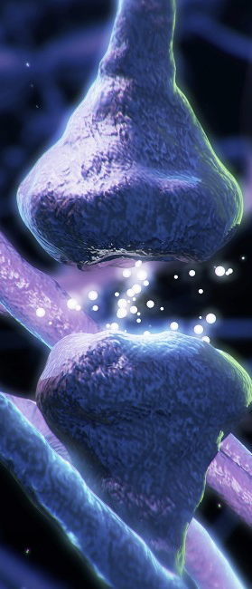
Ketamine
Mechanism of Action:
NMDA receptor antagonist ⇨↑ BDNF and mTOR activity ⇨ synaptic plasticity
Disrupts the Default Mode Network (DMN) ⇨ cognitive flexibility
Subjective Effects:
Dissociative - out of body experience, detached bird’s eye view of one’s life & situation
Therapeutic Result:
Promotes neuroplasticity and ability to alter negative thought patterns
Krystal, J.H., et al. (2023). Ketamine and rapid antidepressant action: new treatments and novel synaptic signaling mechanisms
Kang, M.J., et al. (2022). The mechanisms behind rapid antidepressant effects of ketamine

Slide 21
Ketamine
Administration
Most Common:
IV Infusion - Series of 6 treatments → Maintenance dosing 1x/month.
Esketamine (nasal spray) – 2x/week x 1 month, 1x/week x 1 month, 1x every 1-2 weeks ongoing for maintenance
Indications:
Treatment-Resistant Depression
Acute Suicidality
Generalized Anxiety Disorder
PTSD
OCD
Eating Disorders
Substance use disorders
Frontline healthcare worker burnout

Slide 22

MDMA- Assisted Therapy
Mechanism of Action:
↑ release of neurotransmitters ⇨ serotonin, dopamine, NE
Neurohormonal Effect ⇨ increases oxytocin
↑ BDNF ⇨ neuroplasticity
Subjective Effects:
Empathogen ⇨ engenders feelings of love & warmth
Lowered anxiety/fear response, enhances emotional openness and trust
Rarely causes hallucinations or alterations in perception of self
Therapeutic Result:
Therapy adjunct ⇨ Patients can revisit trauma whilst fear or other emotional defense mechanisms are suspended
Memory reconsolidation ⇨ rewrites maladaptive memory associations and enhances fear extinction
Sottile R.J., et al. (2022). A proposed mechanism for the MDMA-mediated extinction of traumatic memories in PTSD patients treated with MDMA-assisted therapy

Slide 23
MDMA- Assisted Therapy
Administration
One prolonged treatment period (months)
Intensive therapy framework
Indications:
PTSD
Under Investigation:
Eating Disorders
Social Impairment in Autism
Anxiety related to Life-threatening Illness
Substance use disorders
Couples therapy

Slide 24
Patient Considerations - Contraindications
KETAMINE
MDMA-ASSISTED THERAPY
PSYCHOLOGICAL
Active mania/psychosis
MEDICAL
Uncontrolled HTN
Aneurysm (*clearance)
Hx aortic dissection, ICH (*clearance)
Hx MI, arrhythmia (*clearance)
Cystitis (*relative contraindication)
Pregnancy/lactation
PSYCHOLOGICAL
Primary psychotic disorder
Bipolar I
DID / Severe Personality disorders
Eating Disorder w/ Purging
Active substance abuse disorder
Serious Suicide Risk
MEDICAL
Uncontrolled HTN
Baseline QTc prolongation / cardiac risk factors
Symptomatic liver disease
Pregnancy/lactation
Mitchell, J.M., et al (2021). MDMA-assisted therapy for severe PTSD: a randomized, double-blind, placebo-controlled phase 3 study

Slide 25
Patient Considerations - Medication Interactions
KETAMINE
MDMA-ASSISTED THERAPY
Benzodiazepines → Muted effects; hold day of tx
Lamotrigine → Muted effects
Stimulants → hold day of tx
SSRIs/SNRIs/TCAs→ Muted effects and ↓ efficacy
Mirtazapine & Trazodone → Muted effects
MAOIs → Contraindicated - serotonin toxicity
Benzodiazepines → Muted effects, possible ↓ efficacy
Stimulants → Added stimulant toxicity
Lithium → Contraindicated - increased risk seizures
CYP2D6 inhibitors (Bupropion) → Increases blood concentrations of MDMA
CYP3A4/5 inhibitors (Ritonavir/cobicistat) → Potentially fatal serotonin toxicity
Mitchell, J.M., et al (2021). MDMA-assisted therapy for severe PTSD: a randomized, double-blind, placebo-controlled phase 3 study

Slide 26
Patient Considerations - Accessibility
KETAMINE
MDMA-ASSISTED THERAPY
Legal in all 50 states
Only legal if part of clinical trial
Recruiting (as of 2/16/25):
MDMA Plus Exposure Therapy for PTSD
(Emory University)
MDMA for AUD/PTSD Comorbidity
(Brown University)
MDMA-Assisted Massed Prolonged Exposure for PTSD (MDMA-PE) (VA - San Diego)
MDMA-Assisted Brief Cognitive Behavioral Conjoint Therapy for PTSD (MDMA-bCBCT) (VA - San Diego)
Not Yet Recruiting (as of 2/16/25):
MDMA-Assisted Therapy vs CPT for Veterans with Severe PTSD (VA - Palo Alto)
MDMA-Assisted Therapy for Veterans with Moderate to Severe PTSD (VA - Los Angeles)
Source: Clinicaltrials.gov
Notes:
There’s always the underground…

Slide 27
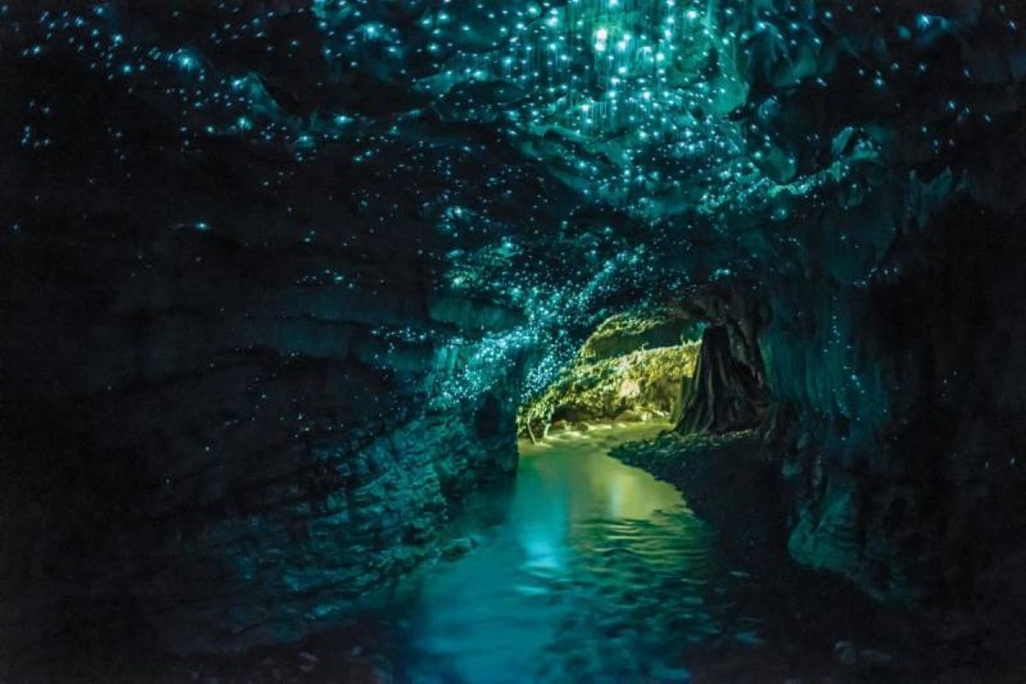

Slide 28
Back to Our 55y Veteran with PTSD…
Ketamine = Rapid relief, help with depression, ongoing treatment.
MDMA = Deep trauma processing, lasting change.
In an ideal world …..could benefit from both
Ketamine first to help taper off antidepressant & improve depression & SI
MDMA to focus on PTSD

Slide 29
Leslie Me
Psilocybin
Mikhail Kogan, MD
George Washington University
GW Center for Integrative Medicine

Slide 30
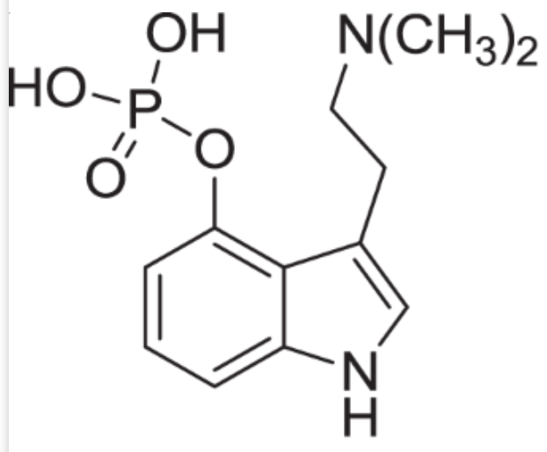
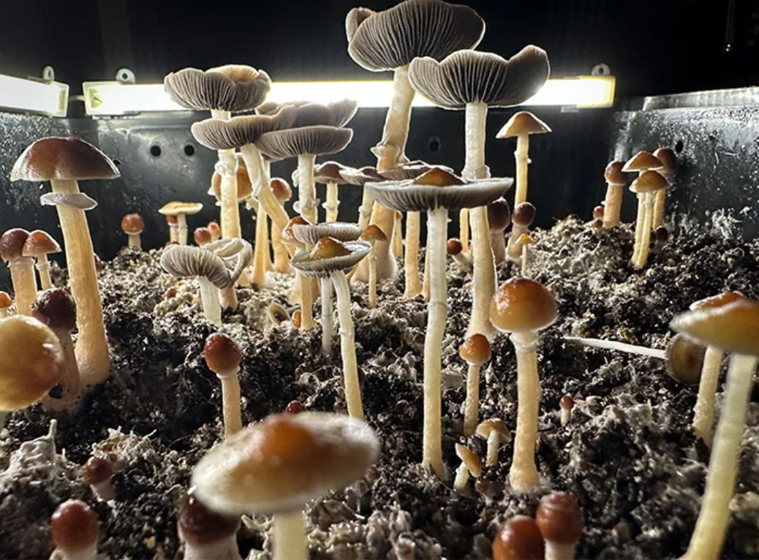
Psilocybin (Mushrooms)
MOA: Serotonin receptor agonist, particularly targeting 5-HT2A receptors
Route: Typically oral, consumed in dried mushroom form or as an extract (note most trials to date use injection of pure extract)
Effects: Euphoria, altered perception of time and space, visual and auditory hallucinations, introspection, spiritual experiences
Side Effects: Nausea, anxiety, paranoia, increased heart rate, pupil dilation, derealization or depersonalization
Combining with SSRIs/SNRIs: May diminish effects due to serotonin receptor competition; potential for increased risk of serotonin syndrome, use caution

Slide 31
Let’s look at 2 cases
Who? | Kate 62 year old woman with metastatic ovarian cancer. on palliative care | Brian 36 year old man with long standing mild depression contributing to problems at home with wife and children. Never felt any help from Antidepressants
Why? | Struggling with accepting death and looking for more peace in last months | Hoping to improve depression and better family relationships
Why Psilocybin? | Perception of “softer more mystical experience” | Friend did it for his depression and had amazing improvement
Anticipation/Expectation | Mystical experience/Closer connection to God, reinstate lost faith | Break from reality into nonlinear healing

Slide 32
2 Cases continue
 | Kate | Brian
Settings | Weekend long retreat in cabin the woods 2 participants - Kate and her husband | Weekend long retreat in cabin the woods 5 participants all young people in 20s-40s
Preparation | Several meetings with psychedelic coach, meeting with psychiatrist and palliative care social worker | One meeting with psychiatrist and conversation with friend and one meeting with psychedelic coach
Dose/Type | High dose (ground mushroom) mixed with yogurt (patient’s request) | High dose mushroom chewed directly (patient’s request)
Psychedelic effects | Minimal psychedelic effect, more like relaxation and periods of peace without any major “God like moments” | Profoundly deep state of awareness of unity and peace for 3-4 hours, long profound conversation with one of the coaches at the end of the trip

Slide 33
2 Cases continue
 | Kate | Brian
Side effects | Intermittent nausea and vomiting that led to need for IV hydration. | None
Day after/Early Integration | Some decrease in anxiety, difficult integration due to severe side effects. | Barely can speak, feels that entire world shifted, lots of tears of joy, integration mostly listening and meditating with others.
Long term feedback after 12 weeks | Felt that experience was not worth money and effort despite still grateful for being able to do it. | “My life is so different, as if I had 10 years of therapy squeezed into 6 hours.”

Slide 34
So what happened with our patients?
 | Kate | Brian
Anticipation vs Reality | Anticipated a lot but being frail and struggling with pre-existing cancer related symptoms led to severe purging that patient was not able to get through to the actual true psychedelic experience despite coaching. | Was guarded but effect was beyond anything anticipated.
Right Choice? Wrong Choice? How could this be improved? | Pretreating with strong anti-emetic if patient insists on trying but really - may be not the best substance and trial of Ketamine would have been better. | Right Choice
Main lessons | Frailty and advanced illness makes psilocybin sessions unpredictable and physiological side effects more common. | High dose combined with decent preparation for depression can be life transforming in 1 session.

Slide 35
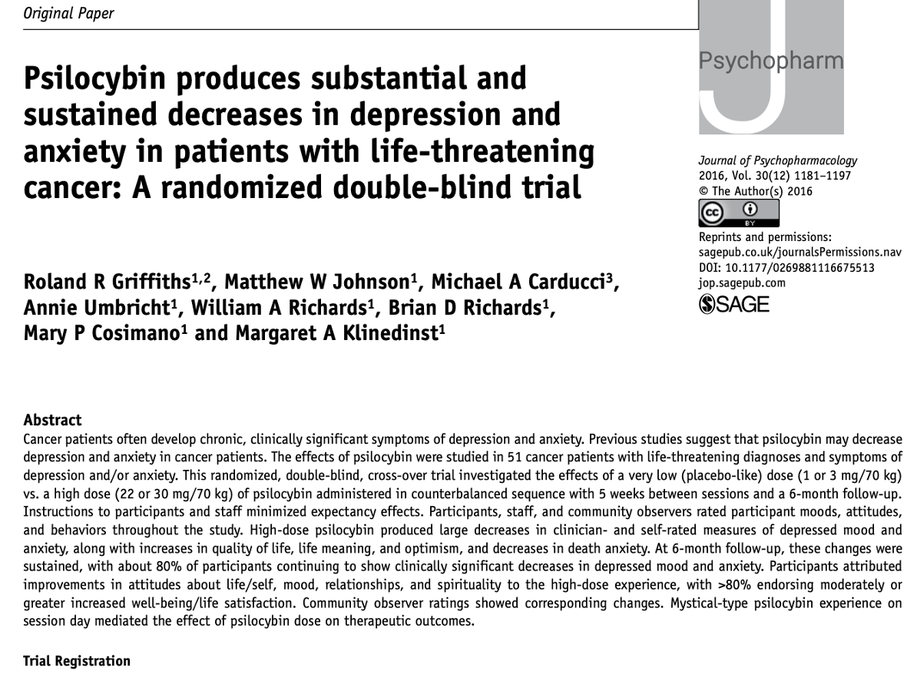
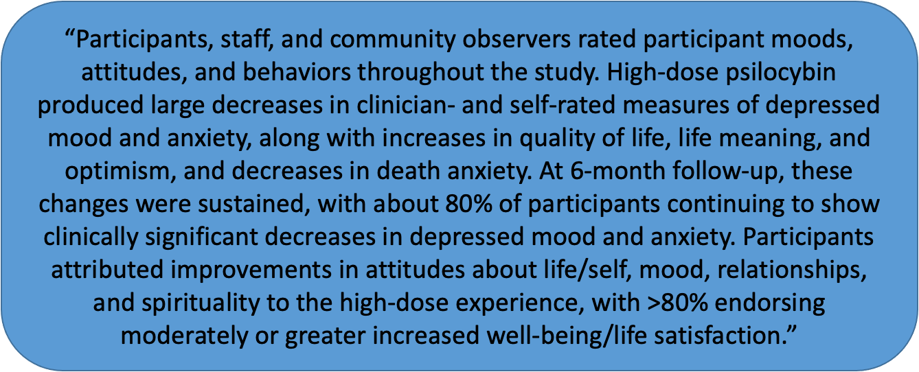
Real Life vs Studies?

Slide 36
Contraindications Precautions
🚫 Unstable psychiatric conditions or significant risk of psychosis
🚫 Uncontrolled cardiovascular disease
🚫 Pregnancy & breastfeeding
No clinical safety data available
✅ Serotonergic Medications - decrease efficacy theoretical risk of serotonin syndrome
✅ Severe Anxiety, PTSD with Dissociation, or History of Panic Attacks
Can exacerbate acute distress or induce extreme panic episodes.
✅ Anticipate psychological and physical distress and be ready to manage it:
Anxiety, Panic Attacks, Prolonged perceptual disturbances
Nausea, Vomiting, Diarrhea, accidents if tries to move while disoriented (must have 1:1 seater at all times)

Slide 37
Leslie Me
“The Psychedelic Experience” - Practical Guidance for Conscious Journeying & Harm Reduction
Thais Salles Araujo, MD: Institute for Integrative Healology, UCLA East-West Medicine, Modern Medicine, Mystic Health, Roze Room Hospice & Palliative Care
Justin Laube, MD: Institute for Integrative Healology, UCLA East-West Medicine, Modern Medicine, Everyday Health

Slide 38

What is our role, as integrative practitioners, in guiding our patients with psychedelic medicines?
→Patients under report psychedelic use, just like CAM use
→There is mounting evidence of benefits for deep suffering states
→If a patient is bringing up psychedelics, it’s likely a sign of their trust in you to help them navigate a confusing landscape
→What is a way to engage with your patient using evidence and safety guided directioning without quick judgment or dismissal?
→Perhaps we can apply our integrative open-minded evaluative capacity to psychedelics, just like any other complementary or integrative therapy
St. Pierre, M., Standing, L., Herman, Y., Haden, M., & Walsh, Z. (2024). Patients' experiences discussing psychedelics for therapeutic purposes with physicians and other health care providers. Psychedelic Medicine, 2(3). https://doi.org/10.1089/psymed.2023.0060

Slide 39
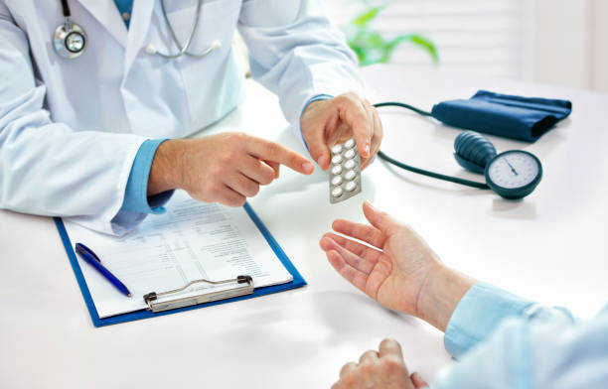
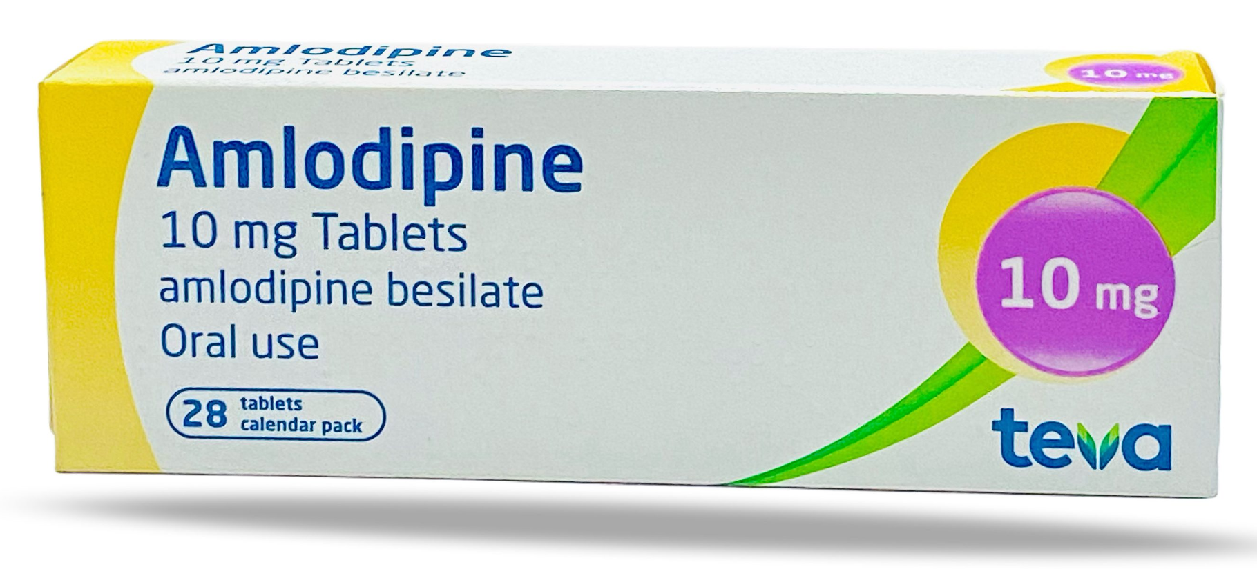
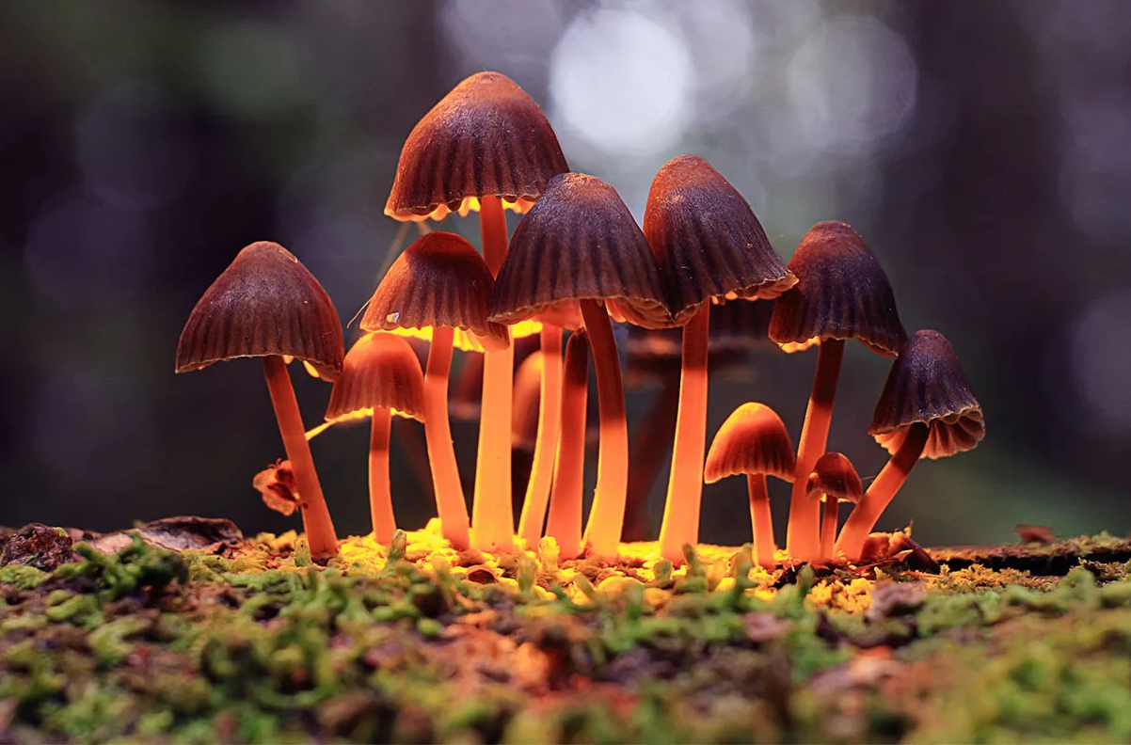


Usual State:
Prescribing medications that don’t cause significant acute changes in consciousness, therefore don’t require special considerations around intentionality, preparation, where it’s taken, facilitation, or after-care.
Psychedelics Medicine Experience:
To understand psychedelics requires engaging new lenses that includes these considerations. Plus, Psychedelic medicines are more of an experience than a purely drug effect.
–e.g Experiences of alterations for e.g. in time perception, visual and sensory shifts, ineffable mystical encounters (More of a “trip” or “journey”).
–Some can be life changing, healing and can also be challenging without support or quality care.
Carhart-Harris RL, Roseman L, Haijen E, et al. Psychedelics and the essential importance of context. Journal of Psychopharmacology. 2018;32(7):725-731. doi:10.1177/0269881118754710 https://journals.sagepub.com/doi/abs/10.1177/0269881118754710

Slide 40

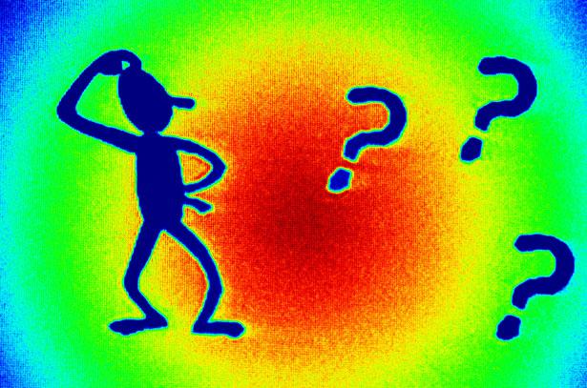


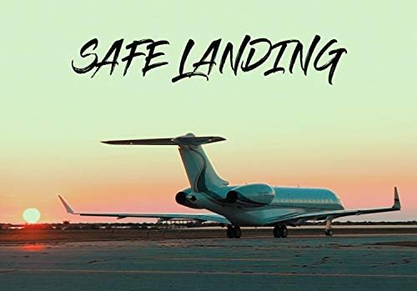

Psychedelics as a mind-body-spirit Surgery-Journey
Post-Op
Decisions
Pre-Op
Surgery
& Recovery
Pre-operative risk guidance visit
“Travel” visit
“Mind-body-spirit” Psychedelic Surgery experience”
Immediate, short term & longer term
Your patient comes with questions or intentions to explore psychedelics for healing.
  Focus on safety, education and risk minimization without judgment or stigmatizing
  Respect for patient’s autonomy and longing to heal
[Trusted allied health, CAM practitioners, therapeutic integration 1:1/groups]
Who?
[Psychedelic-informed health practitioner]
[Depends on setting]
[Trusted health practitioner]

Slide 41

Case: Henry
53 year old man going through a divorce who is feeling anxiety and depression. He has a friend who had a positive experience at an Ayahuasca healing retreat in South America and at his medical visit he asks what you thought about it…
Decisions
Goal: Reduce potential harms & supporting potential benefits (and patients goals to just feel better)
[Trusted health practitioner]
Gorman, I., Nielson, E. M., Molinar, A., Cassidy, K., & Sabbagh, J. (2021). Psychedelic harm reduction and integration: A transtheoretical model for clinical practice. Frontiers in Psychology, 12, Article 645246. https://doi.org/10.3389/fpsyg.2021.645246

Slide 42


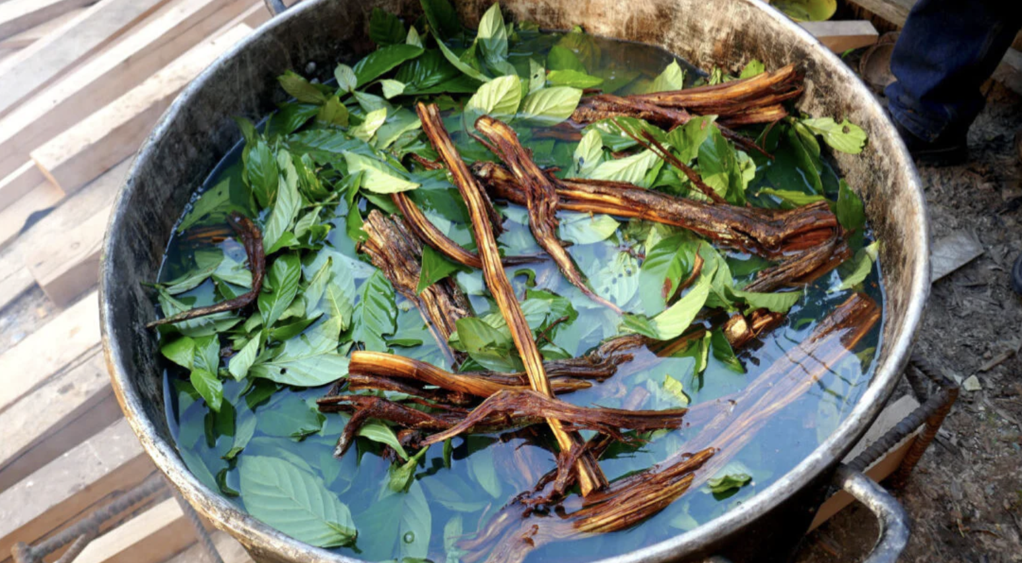
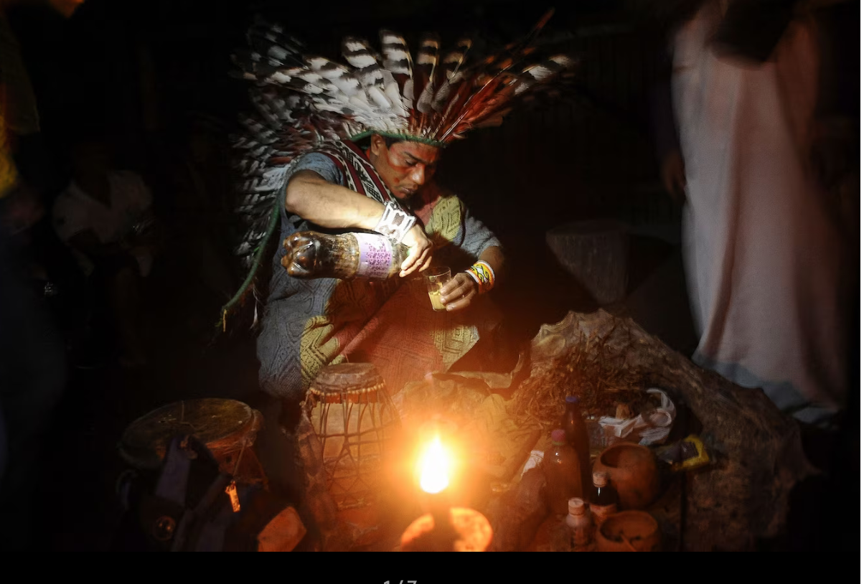
Ayahuasca - “aya, what?”
Traditional healing plant from the Amazon basin - a leaf containing DMT and a vine containing an MAO inhibitor into a brew.
Mechanism of action: 5-HT2A receptor activation.
Duration: 4-6+ hours
Subjective effects: Visual patterns, contact with ‘beings’, heightened perception.
Side effects: “The purge”: vomiting, diarrhea; increase BP, HR
Growing research use: depression, anxiety, substance use disorder, grief
Considerations: Most often used ceremonially in jungle by indigenous people, or religious settings; Has most potential drug interactions due to MAO activity. Difficult to know dosing (variable concentrations, proportions)

Slide 43




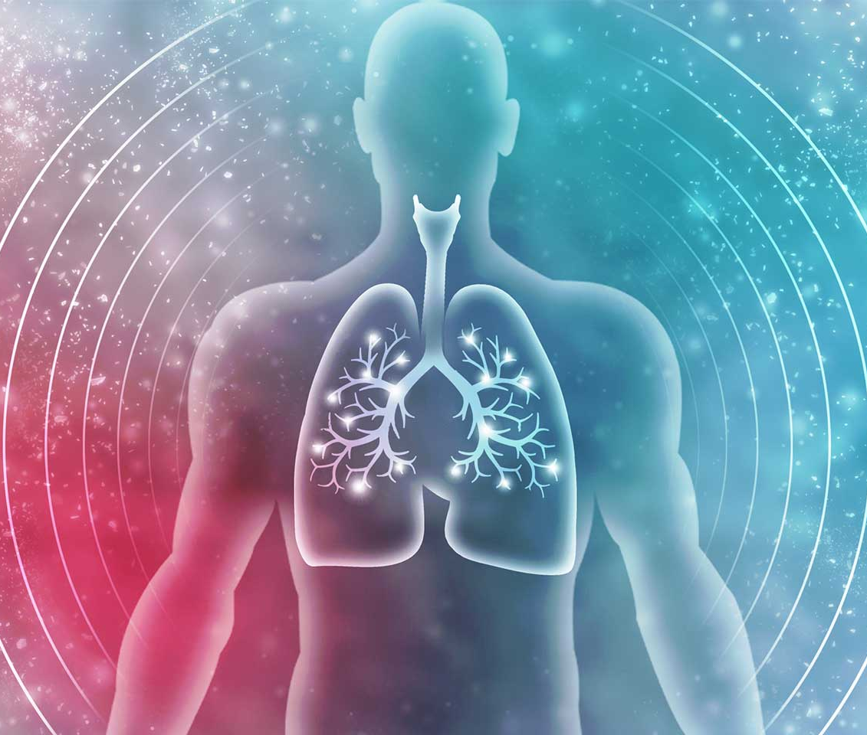
Psychedelic Medicines - Practical Comparing for Evidence-Informed and Safer Steering
MDMA
KETAMINE
PSILOCYBIN
Entheogen
Organic, softer, introspective
Connection with nature/spiritual
Somatic: variable, some nausea
4-6h
MDD, TRD, Existential Distress in terminal Illness
Empathogen
Connection/Love - Self & others
Lowers fear responses
Somatic: activating, energizing
3-6h
PTSD
Dissociative
Bird’s Eye Perspective
Rapid effects
Somatic: sedative, relaxation, nausea/motion sickness sens
1-3h
TRD (FDA-approved esketamine), MDD w/ suicidality (FDA), Chronic Pain
AYAHUASCA
Entheogen
Introspective, deep psychological processing
Connection with nature and spiritual realms.
Somatic: highly activating, physical & emotional release, Purging
4-8h
Addiction, Depression, Grief (research early though)
Non-drug Natural “Psychedelic States”
E.g. Prolonged meditation retreats, spiritual retreats, pilgrimages, holotropic breathwork, fasting, nature quests, shamanic journeying, music/drumming deep experiences. Yes, these can be just as powerful.

Slide 44
Henry’s
1. Start: “Tell me more…” “Why now?” | “Sadness is impacting my work, and therapy + antidepressants didn’t cut it, and my sexual function is impacted...”
2. Previous tx - Other options? | s/p SSRI + CBT 6 months
3. Indication and Intention | Depression, ongoing grief s/p divorce
4. Where/Who - Training Standard Research, clinical, underground, church, abroad – (1:1, group, multi-day, retreat) | Retreat center in Colombia with US physician advisory. With therapists, and relationship to local indigenous shaman. Trauma-informed. Has ethical guidelines, medical evac plan.
5. Contra-indications | No CV disease or psychotic disorder. No FHx of psychotic disorders.
6. Medication interaction | Off SSRI, only amlodipine for HTN
7. Physical health - METS | Exercises 5x per week, high METS. No GI issues.
8. Mental health and therapy support | Has strong family support, friend who’s been to the center. Has therapist still available.
Decisions
Pre-Op

Slide 45
Henry visit continued:
Additional Considerations, which may fall to the psychedelic medicine specialist:
Finances involved and patients resources?
Preparation and integration offered? Standard of care.
What: Dosing and Purity
  (Substance purity testing, verification - how do you know, for sure?)
  Risk exploration across settings and legality
When to refer to a psychedelic medicine specialist (e.g …) and who?
  MAPS, CIIS, Fluence, PRATI, Integrative Psychiatry Institute (IPI), Usona, Polaris
  Experience at a psychedelic-ketamine clinic, clinical research
End of visit: “Send me a message, or telehealth, to check in after you’re back with a safety and support needed update. I wish you well on your healing journey, if it doesn’t feel right, don’t do it.”
Pre-Op

Slide 46

Henry’s experience
-7 day retreat
-5 overnight ceremonies
-Dieta - traditional preparatory diet
-Prep/Integration circles -English speaking guides
"Surgery trip"

Slide 47

Henry’s Return and Follow-up Visit with his health care team
Post-Op
& Recovery
Q’s: How is your returning process?
Recognize the Neuroplasticity window - few days to weeks.
Give resources for challenging experiences
Encourage integration group w/ trained mental health professionals
Encourage healing as a journey not just peak moments
Consider delaying big decisions
Utilize integrative therapies to support grounding and integration
  Massage, Acupuncture, Qi gong, Art, Journaling, Quiet time, Nature time
de Vos CMH, Mason NL, Kuypers KPC. Psychedelics and Neuroplasticity: A Systematic Review Unraveling the Biological Underpinnings of Psychedelics. Front Psychiatry. 2021 Sep 10;12:724606. doi: 10.3389/fpsyt.2021.724606.

Slide 48
Resources - Psychedelic harm reduction and for patients struggling after a psychedelic experience
https://zendoproject.org/
Provides professional harm reduction education and psychedelic peer support services to organizations and communities.
https://firesideproject.org/
Free, confidential, non-clinical emotional support by phone and text message to people in the midst of psychedelic experiences, people exploring the meaning of past psychedelic experiences, and people who are supporting others who have psychedelic experiences

Slide 49

Call to action: To strike a balance between seemingly opposing forces.
Engineer safe supply of psychedelic substances when legislation allows.
Keep the cost of the medicine session within reach. Insurance may cover integration talk therapy, depending on the therapist.
Promote public and professional education to maximize benefit and minimize potential harms.

Slide 50
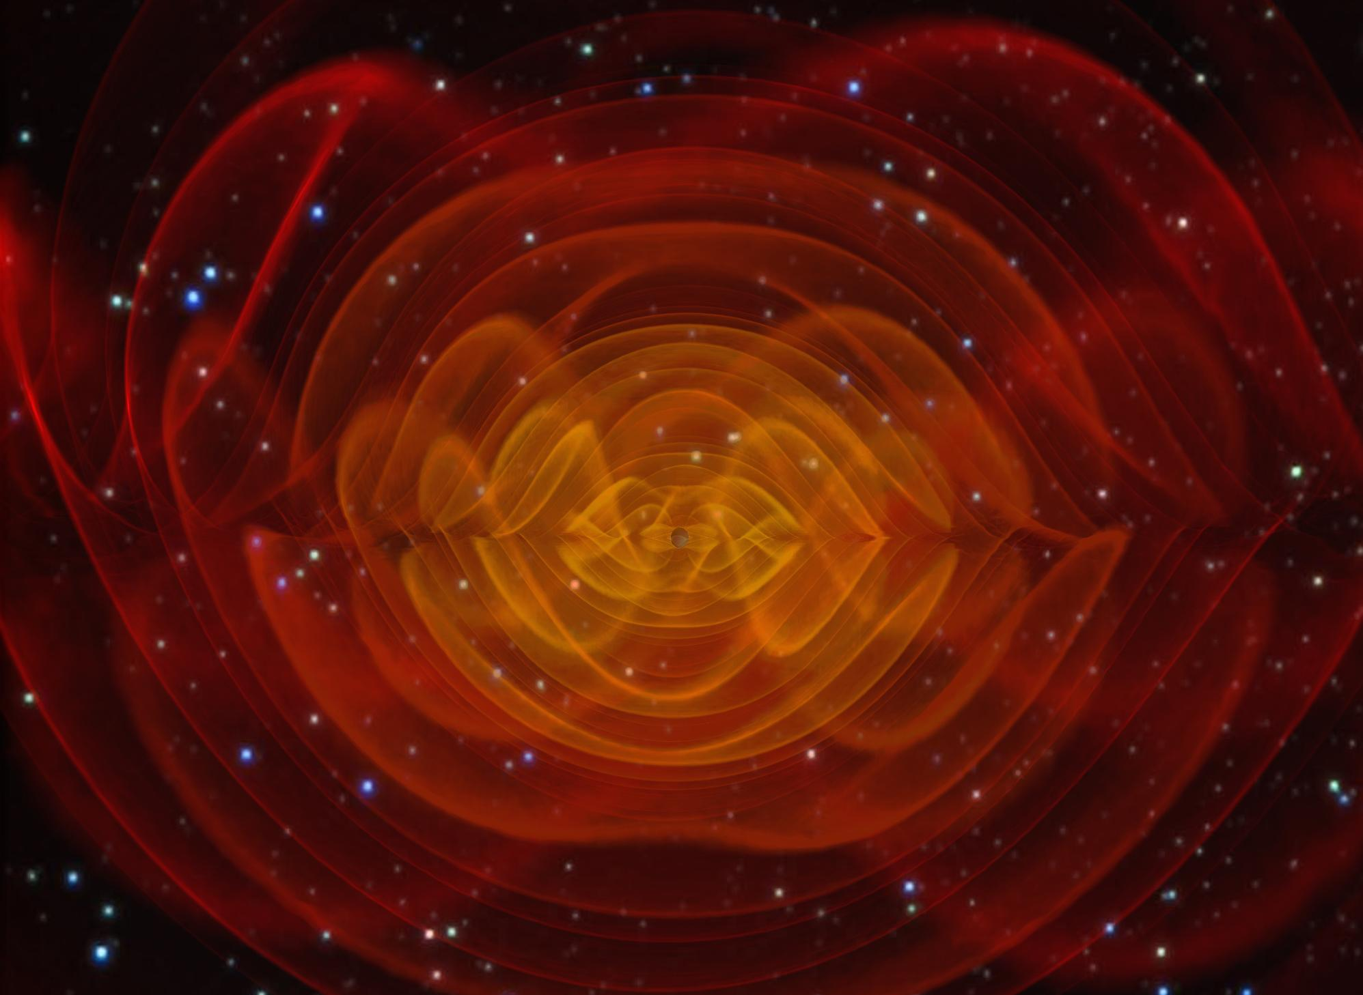
Speakers
Leslie Mendoza Temple, MD: Endeavor Health, University of Chicago Pritzker School of Medicine
Erika Steinbrenner, MD: Imagine Healthcare, Epiphany Wellness, Symetria Recovery
Mikhail Kogan, MD: George Washington University, GW Center for Integrative Medicine
Thais Salles Araujo, MD: Institute for Integrative Healology, UCLA East-West Medicine, Modern Medicine, Mystic Health, Roze Room Hospice & Palliative Care
Justin Laube, MD: Institute for Integrative Healology, UCLA East-West Medicine, Modern Medicine, Everyday Health

Slide 51
Leslie Mevv
Discussion
Notes:
Leslie sorts written questions and distributes to the panelists.

